Slide 1
WELCOME
CONFIGURATION
FOR
GENERAL LEDGER (FI)
Compiled By S.N.HEGDE

Slide 2
Topics
Accounts Groups & Configuring G/L Accounts
B) Field Status Group
C) Posting Key Configuration
D) Automatic Account Determination
E) Financial Statement Version
F) Number Ranges and Document Type

Slide 3
Accounts Groups &
Configuring G/L Accounts

Slide 4
ACCOUNT GROUPS
It is necessary to go through the existing chart of accounts configuration to reduce the number of accounts to those which are essential.
The next step in configuring Chart of accounts is to set up account groups.Account group determine which fields you can configure on the G/L master record..

Slide 5
ACCOUNT GROUPS
You can use the following menu path for account group design: Financial Accounting -> General Ledger Accounting -> G/L Accounts -> G/L Accounts Creation -> one-step Manual/ Automatic (alternative 3) -> Define screen Layout Per account Group (G/L account)
Transaction code: OBD4

Slide 6
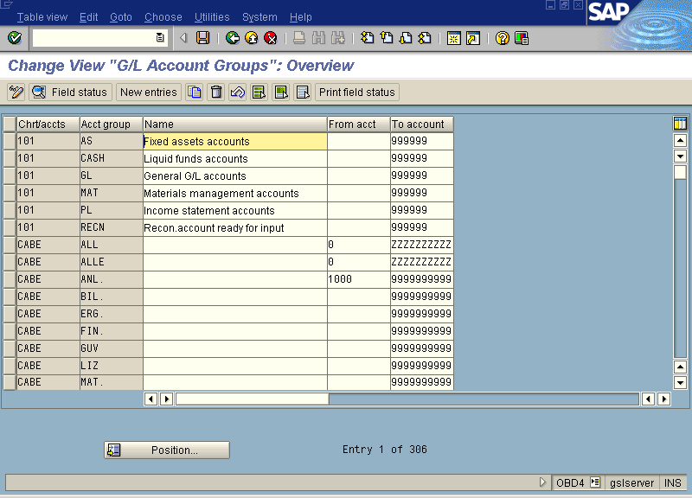

Slide 7
Account Groups for G/L Accounts
Cash
accounts
Cash
Company code specific
settings
000000-099999
C
100000-199999
Asset
Account definition in chart of accounts
200000-299999
General ledger
Material
300000-399999
P/L
Account groups
400000-499999
Account 001111
Liab.
Cash
Account
group
500000-599999
000000-099999
...
600000-699999
Notes:
In order to organize and manage a large number of G/L accounts better, they are arranged in account groups.
The accounts of an account group normally have similar business functions. You could, for example, have an account group for cash accounts, one for expense accounts, one for revenue accounts, and one for other balance sheet accounts, etc.

Slide 8
Reconciliation Accounts
Reconciliation accounts for
customers, vendors, and assets
General ledger
aa
bb
Subsidiary
ledgers
Subsd. ledger
accounts
Customers
Vendors
Assets
aa
bb
Notes:
Reconciliation accounts connect subsidiary ledgers with the general ledger in real-time. This means that a posting to a subsidiary ledger also posts to the corresponding reconciliation account in the general ledger at the same time.
The subsidiary ledgers which are connected to the general ledger via reconciliation accounts are the A/P, A/R, and asset ledgers.

Slide 9
Transaction Figures
G/L account
Line items
.
.
Line items
.
.
1000
Voltas Ltd India
Transaction figure / debit
Transaction figure / credit
7100
Voltas Ltd. Hong Kong
Transaction figure / debit
Transaction figure / credit
7200
Voltas Ltd. Qatar
Transaction figure / debit
Transaction figure / credit
Notes:
A transaction figure is the total of all debit or credit postings. In general, the R/3 System keeps one transaction figure for debits and one transaction figure for credits per account. The financial statements for the company code are calculated using these transaction figures.
If using business areas, transaction figures are also kept per business area (see diagram). If you create a financial statement for the business area, the transaction figures for that specific business area are used to supply the information for the financial statements.

Slide 10
Enjoy - G/L Account Postings
Information area
Header information
Work
templates
Line item information
Notes:
Beginning with Release 4.6 (Enjoy Release), you can comfortably create and post a G/L account document using a one-screen transaction. The entry screen is divided into the following areas:
Work templates (here, you can select screen variants, account assignment templates, or marked documents as references)
Header data (here, the data for the document header is compiled)
Line item information (here, the line items for the document are entered)
Information area (here, the debit and credit totals are displayed)

Slide 11
Retained Earnings Account
Each accounts from P &L needs to be linked to retained earnings account in the COA. Special program is used to transfer the balances to this account at the year end processing (balance carry forward).
Each P&L account is assigned to a retained earnings account via a key. You need to provide this key in the P & L statement type.

Slide 12
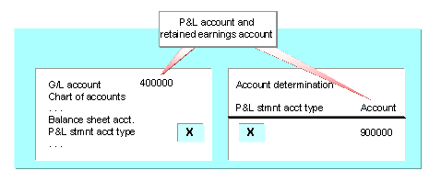

Slide 13
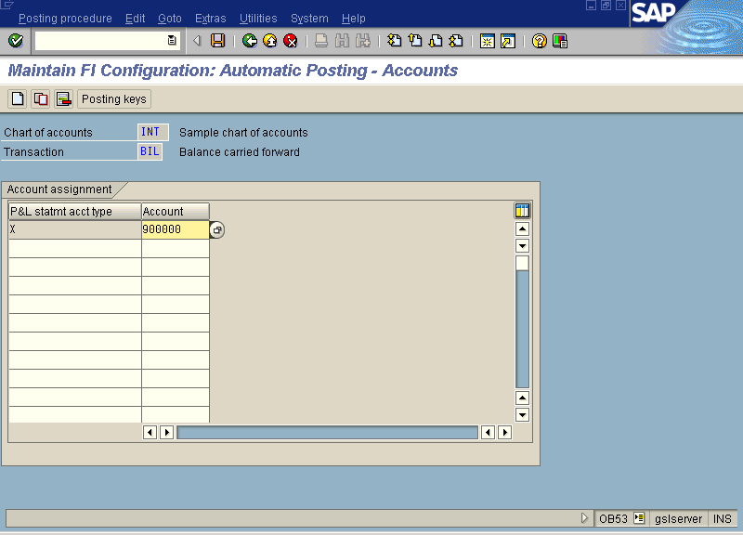

Slide 14
GL Master Record
The GL account is defined at two levels –
- COA
- Company code
Separate screens are available to define the account, and single screen which allows you to maintain the full details (also called as central definition) is also available.

Slide 15
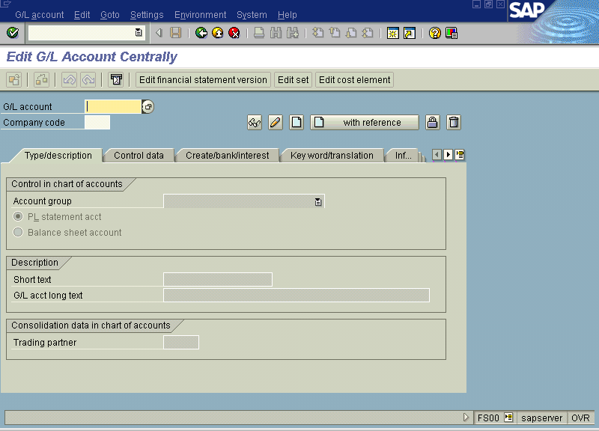

Slide 16
GL account posting
There are many posting screens that can be used which allows you to use different templates.
For example FB50,FV50, F-65,F-02 and many others.
They are used to post JVs or adjustment entries.

Slide 17
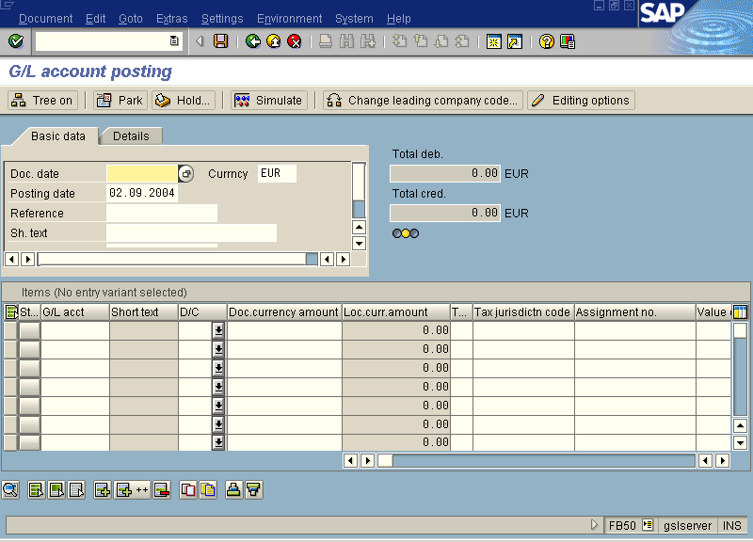

Slide 18
B) FIELD STATUS GROUP

Slide 19
FIELD STATUS GROUP
Field status groups control the additional account assignments and other fields that can be posted at the line item level for a G/L account.
Though fields can be made required or optional or suppressed, the best practice is to make as many fields optional and only most important field as required.

Slide 20
FIELD STATUS GROUP
You can use the following menu path for maintaining field status variants: Financial Accounting -> Financial Accounting Global settings-> Line Item -> Controls-> Maintain field Status Variants.
Transaction code: OBC4.

Slide 21
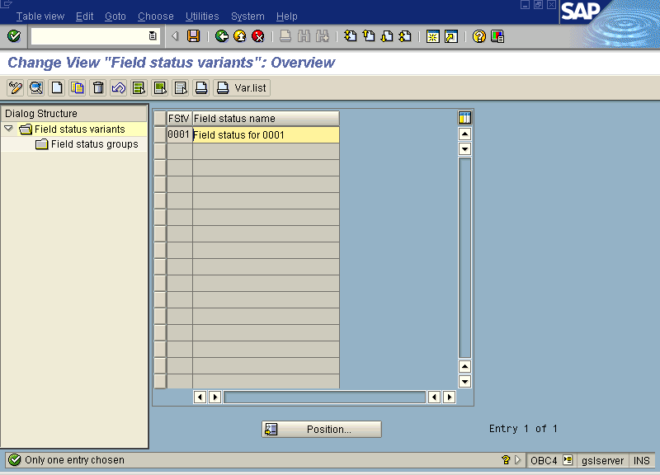

Slide 22
C) POSTING KEY
CONFIGURATION

Slide 23
POSTING KEY CONFIGURATION
Posting key determines whether a line item entry is a debit or credit as well as the possible field status for the transaction.
Modifying the SAP-delivered posting keys is not recommended, in stead it is better to copy the existing posting key that need to be modified and then modify the copy.

Slide 24
POSTING KEY CONFIGURATION
You can use the following menu path for defining the posting keys: Financial Accounting -> Financial Accounting Global settings-> Document ->Line Item -> Controls-> Define Posting Keys.
Transaction code: OB41

Slide 25
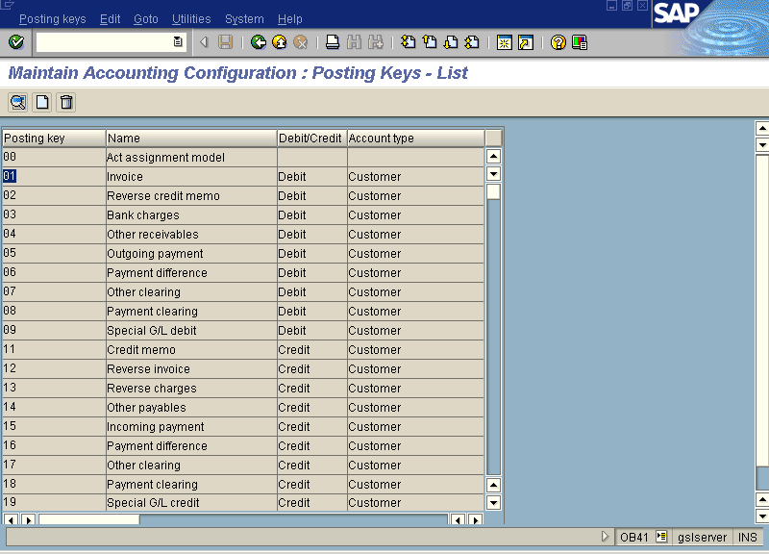

Slide 26
Posting Key
Detail view
Account
1. S, D, K, A, M ?
The posting key (PK) has a control function pertaining to the document line items.
It determines the following:
Item 1 / PK
Amount
Tax ID
2. Debit or Credit?
Additional info.
Business area
Cost center
Text
...
1. Account type for the posting of the line item
2. Posting of line items as debit or credit postings
3. Field status of additional information
3. Field status?
Notes:
Each document line item contains one posting key. This is an instrument that is used for internal control and is used during complex postings to tell the system:
The account type to be posted
Whether it is a debit or credit posting to
Which fields of the line item may have or require an entry
In the new Enjoy transaction, you no longer need to enter the posting key. It does, however, appear in the document and its control functions are still relevant.

Slide 27
Standard Posting Keys
Customers
Vendors
General Ledger
01
02
03
04
05
06
07
08
09
11
12
13
14
15
16
17
18
19
21
22
23
24
25
26
27
28
29
31
32
33
34
35
36
37
38
39
40
80
81
83
84
85
86
50
90
91
93
94
95
96
For postings to G/L accounts from MM
Assets
Material
70
75
89
99
Notes:
In the R/3 System, there are a large number of standard posting keys which should be used. Each posting key is used for postings to a certain side of accounts of certain account types.
For postings in the general ledger, you only need two posting keys:
40 for debit items
50 for credit items

Slide 28
E) AUTOMATIC ACCOUNT
DETERMINATION

Slide 29
AUTOMATIC ACCOUNT DETERMINATION
Automatic Account Determination ( also known as Automatic Postings or Automatic Account Assignment) allows the system to determine the correct G/L account to post to by considering the type of transaction and other factors. All account determination is configured in table T030 and table T001U. It is important to know that while transporting the account assignment, the whole table is transported and not the only changes in the table.Hence it is important to have tight control on account assignment.

Slide 30
AUTOMATIC ACCOUNT DETERMINATION
The configuration of automatic account determination is located at various places throughout to correspond with the application area of automatic account determination. The best way is to use following transaction code.
Transaction code : FBKP

Slide 31
AUTOMATIC ACCOUNT DETERMINATION for MM
Material Management automatic determination is major integration point between FI and MM. Accurate configuration takes a good working knowledge of the different movement types, valuation classes and transaction in MM.
To configure automatic account assignment in MM, the menu path is Financial Accounting-> General Ledger Accounting->Business Transaction-> Integration-> Materials Management->Define Accounts for Material management
Transaction code : OBYC

Slide 32
AUTOMATIC ACCOUNT DETERMINATION for SD
Like MM, SD automatic determination is major integration point between FI and SD. SD account assignments depend on condition tables and access sequence to determine the correct G/L account. classes and transaction in MM.
To configure automatic account assignment in FI, the menu path is Financial Accounting-> General Ledger Accounting->Business Transaction-> Integration-> Sales & Distribution -> Prepare Revenue account Determination
To configure automatic account assignment in SD, the menu path is Sales & Distribution -> Basic Function-> Account Assignment-> Revenue account Determination

Slide 33
E) FINANCIAL STATEMENT
VERSION

Slide 34
FINANCIAL STATEMENT VERSION
Financial Statement Versions group together related accounts into balance sheet and income statement format for financial reporting purposes. SAP uses the financial statement versions assigned to the company code when preparing the standard balance sheet and income statement reports in the system. The groupings in the financial statement version may or may not correspond to the account groupings that were configured earlier. You can assign accounts from different account groups in the same hierarchy nodes (groupings) in the financial statement version.

Slide 35
FINANCIAL STATEMENT VERSION
The following menu path can be used to get to the financial statement version definition: Financial Accounting -> General Ledger accounting -> Business Transactions -> Closing -> Document -> Define Financial Statement Version
Transaction code : OB58

Slide 36
Financial statement versions
Financial statement
1000
Financial statement 7100
Financial statement
7200
Assets
Liab. & OE
Assets
Liab. & OE
Assets
Liab. & OE
Items
- Sub-items
- ...
Items
- Sub-items
- ...
Items
- Sub-items
- ...
Items
- Sub-items
- ...
Items
- Sub-items
- ...
Items
- Sub-items
- ...
P&L
P&L
P&L
Items
- Sub-items
- ...
- ...
Items
- Sub-items
- ...
- ...
Items
- Sub-items
- ...
- ...
... and many additional financial statement versions
Notes:
A general ledger is kept in order to provide the information needed to create a balance sheet and a profit and loss statement. These reports have to meet country-specific requirements, that is, IDES, for example, would need to create financial statements based on HGB (German standard) for company code 1000 (Germany) and based on US-GAAP for company code 3000 (USA).
To meet the various reporting requirements, various financial statement versions have be created in the R/3 System. In these financial statement versions, you define exactly which accounts are to appear in which line items of the financial statement. Many financial statement versions are included in the R/3 Standard System.
When running financial statement reports, you select a financial statement version that contains the details of the report structure.

Slide 37
F) NUMBER RANGES &
DOCUMENT TYPE

Slide 38
NUMBER RANGES & DOCUMENT TYPE
Document types are used for different transactions throughout the system.
The document type controls many things , including the type of account that can be posted to, the number range assigned to it and required document header fields
Though SAP comes delivered with several standard document types, you have the option of creating new document type.

Slide 39
NUMBER RANGES & DOCUMENT TYPE
Before posting any transaction, document type and its number range need to be configured. SAP comes delivered with several different document types that are assigned to different transactions in the system. Each document type must have a number range assigned to it. The number ranges are what determines the document number.

Slide 40
Important Standard Document Types
Customer
credit memos
Customer
payments
G/L account
documents
Customer
invoices
DG
DZ
SA
DR
Vendor
credit memos
Vendor
invoices
Vendor
payments
Accounting Document
KR
KG
KZ
AB
Notes:
In order to distinguish between the various FI documents, document types are used. Each document is assigned to one document type, and this is entered in the document header. Document numbers are provided by the document number ranges assigned to one or more document types.
For G/L account postings, document type SA is used, although other document types are possible (such as accrual/deferral documents, valuation documents, and so on).

Slide 41
NUMBER RANGES & DOCUMENT TYPE
For Creating the Document Type use the following menu path: Financial Accounting -> Financial Accounting Global settings-> Document ->Document Header-> Document Type.
Transaction code: OBA7

Slide 42
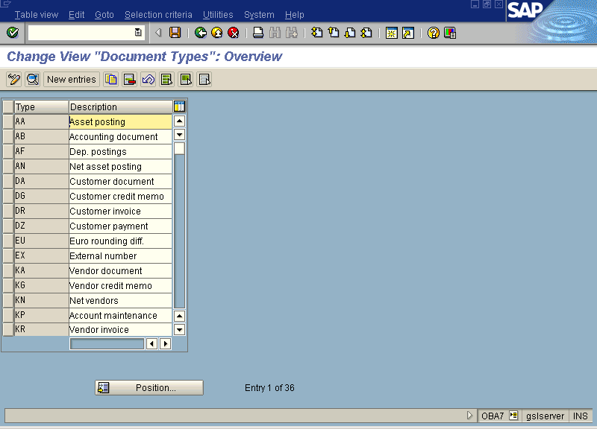

Slide 43
NUMBER RANGES & DOCUMENT TYPE
You can use the following menu path for defining the number range.: Financial Accounting -> Financial Accounting Global settings-> Document ->Document Number ranges-> Define Document Number Ranges.
Transaction code:FBN1

Slide 44
